Slide 1

Presentation: AirBnB Investment
By: Melissa & Dan
Notes:
Prompt 4: What neighborhood in Amsterdam receives the most positive reviews?

Slide 2
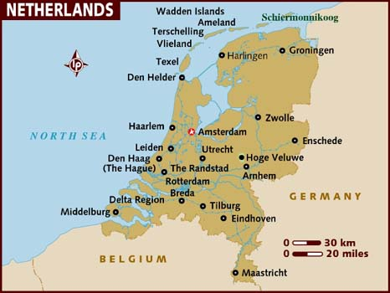
First, Where is Amsterdam?

Slide 3
Overview
What neighborhood in Amsterdam receives the most positive reviews?
Data Analyzed: 222,773 counts of data (cell values)
Location of the neighborhood: 22 neighborhoods in Amsterdam w/ data collected
The number of reviews: 108353 total reviews
Review score rating: Average ~92%
The make of of scores for each rating and how they are applied to the overall rating: Overall, Cleanliness, Accuracy, Communication, Checkin, Value, Location
Notes:
How did we clean the data? Was there any data inconsistencies? We removed the blank spaces, removed those with 0 reviews, and made sure that the cities all listed in Amsterdam, North Holland.

Slide 4
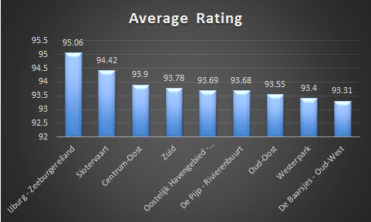
Top Neighborhoods in Rating by Performance Reviews
Top Three Neighborhoods
IJburg - Zeeburgereiland 95
Slotervaart 94
Centrum-Oost 93
Notes:
Neighborhood
Average Rating
IJburg - Zeeburgereiland
Ratings are based on
95
Slotervaart
94
Centrum-Oost
93
Zuid
93.78
Oostelijk Havengebied - Indische Buurt
93.69
De Pijp - Rivierenbuurt
93.68
Oud-Oost
93.55
Westerpark
93.4
De Baarsjes - Oud-West
93.31

Slide 5
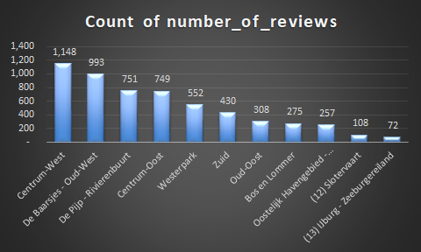
Top Number of Reviews by Neighborhood
Top Three Neighborhoods:
Centrum-West 1,148
De Baarjes-Oud-West 993
De Pijp-Rivierenbuurt 751

Slide 6
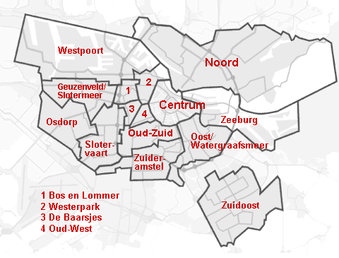
Map of Amsterdam Neighborhoods
Centrum/Zeeburg Downtown Red Light District
Slotervaart Airport

Slide 7
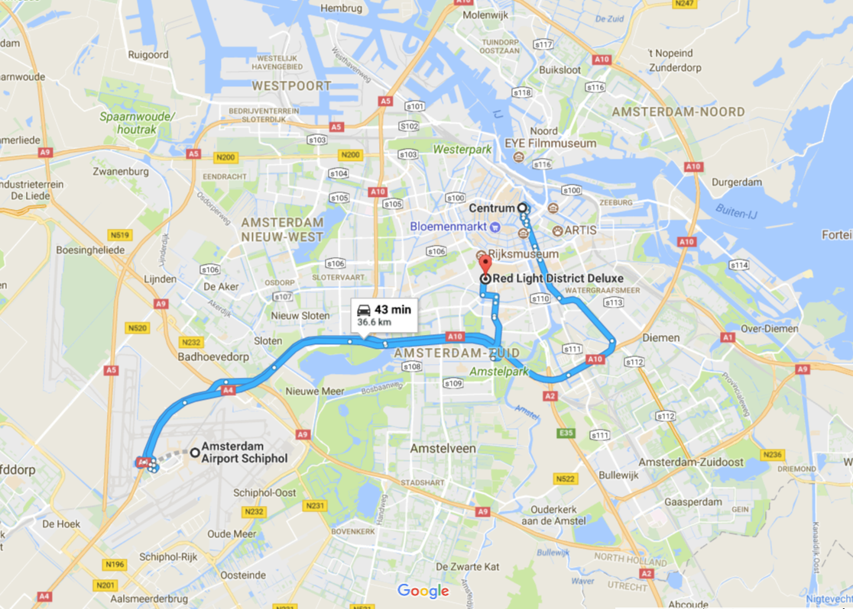
Map of Amsterdam

Slide 8
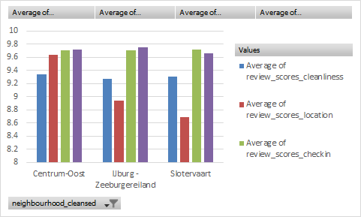
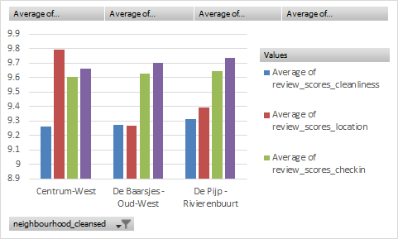
Recommendations
Look to see what attractions are in each neighborhood.
Look at the top people hosts are with the best ratings.
Breakdown of reviews:
By Average Review: By Most Reviews

Slide 9
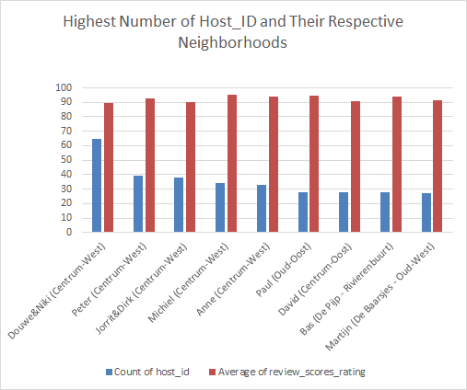
Look at the review of those who host in the neighborhood
Are they safe?
Are they friendly?
Do they provide true comfort and exposure to the city?
Where are people usually staying?
etc...
Centrum-West/Oost has the highest number of reviews for the hosts (downtown)
and of course....
Notes:
Centrum west/oost is downtown
Average # of reviews= 11. Standard deviation= 36 highest= 65, lowest= 1

Slide 10
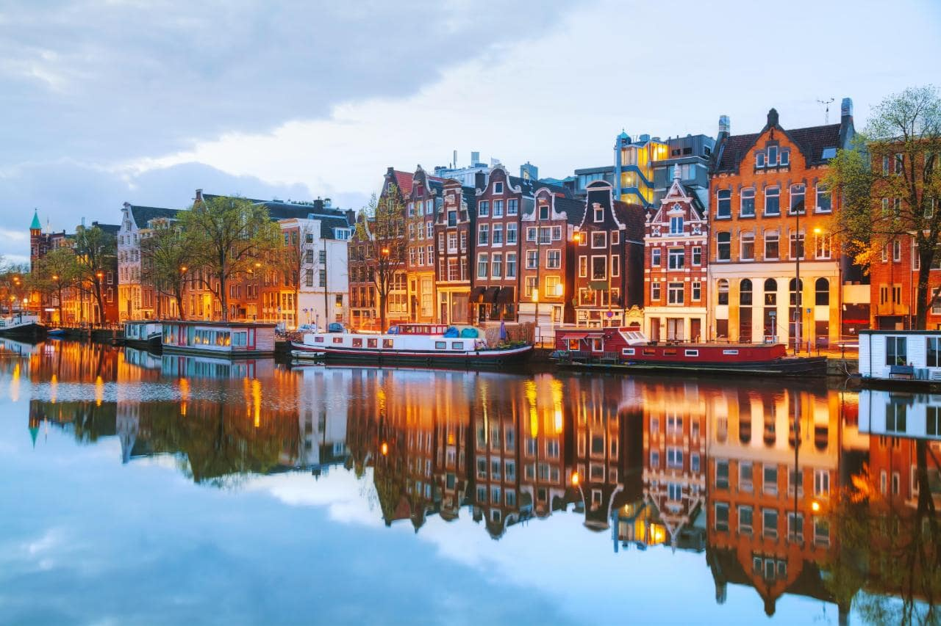
Google Pictures!

Slide 11
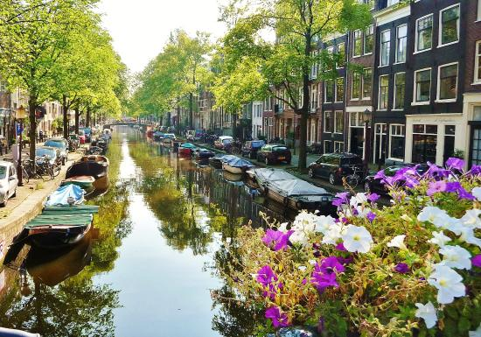
Google Pictures!

Slide 12
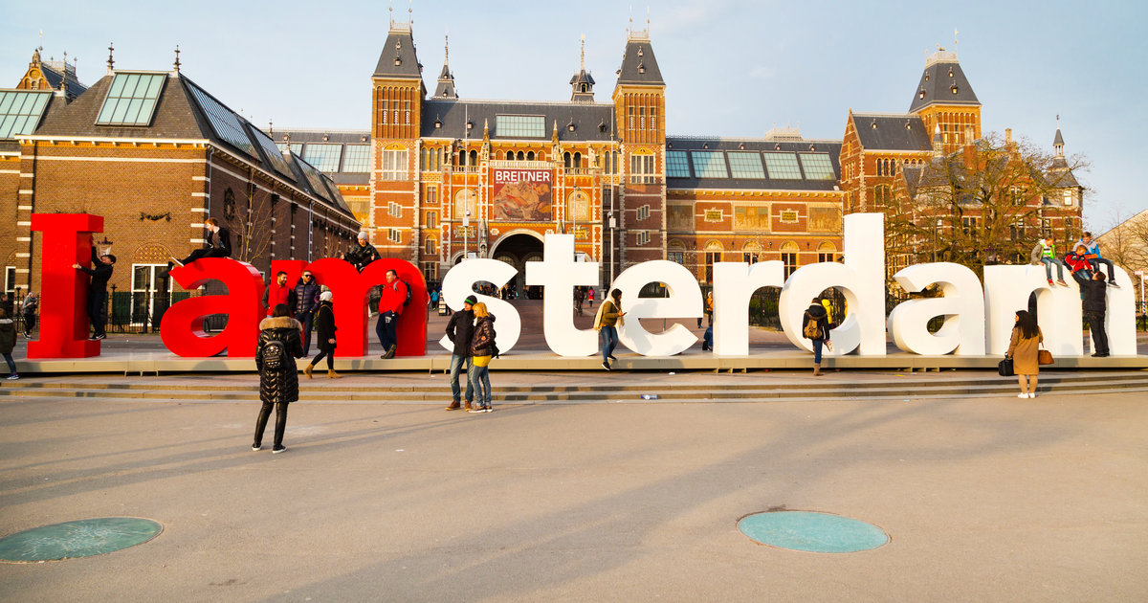
Google Pictures!

Slide 13

Google Pictures!

